Slide 1
Lecture 8 – Parallel Computation Patterns (Stencil)
CSD2170 Programming Massively Parallel Processors
Lecture 8.1 Convolution

Slide 2
Objective
To learn convolution, an important method
Widely used in audio, image and video processing
Foundational to stencil computation used in many science and engineering applications
Basic 1D and 2D convolution kernels

Slide 3
Convolution as a Filter
Often performed as a filter that transforms signal or pixel values into more desirable values.
Some filters smooth out the signal values so that one can see the big-picture trend
Others like Gaussian filters can be used to sharpen boundaries and edges of objects in images..

Slide 4
Convolution – a computational definition
An array operation where each output data element is a weighted sum of a collection of neighboring input elements
The weights used in the weighted sum calculation are defined by an input mask array, commonly referred to as the convolution kernel
We will refer to these mask arrays as convolution masks to avoid confusion.
The value pattern of the mask array elements defines the type of filtering done
Our image blur example in Module/Lecture 3 is a special case where all mask elements are of the same value and hard coded into the source code.

Slide 5
1D Convolution Example
N
N[0]
N[1]
N[2]
N[3]
N[4]
N[5]
N[6]
P
P[0]
P[1]
P[2]
P[3]
P[4]
P[5]
P[6]
1
2
3
4
5
6
7
3
8
57
16
15
3
3
M
M[0]
M[1]
M[2]
M[3]
M[4]
3
4
5
4
3
3
8
15
16
15
Commonly used for audio processing
Mask size is usually an odd number of elements for symmetry (5 in this example)
The figure shows calculation of P[2]
P[2] = N[0]*M[0] + N[1]*M[1] + N[2]*M[2] + N[3]*M[3] + N[4]*M[4]

Slide 6
Calculation of P[3]
N
N[0]
N[1]
N[2]
N[3]
N[4]
N[5]
N[6]
P
P[0]
P[1]
P[2]
P[3]
P[4]
P[5]
P[6]
1
2
3
4
5
6
7
3
8
57
76
15
3
3
M
M[0]
M[1]
M[2]
M[3]
M[4]
3
4
5
4
3
6
12
20
20
18

Slide 7
Convolution Boundary Condition
N
N[0]
N[1]
N[2]
N[3]
N[4]
N[5]
N[6]
P
P[0]
P[1]
P[2]
P[3]
P[4]
P[5]
P[6]
0
1
2
3
4
5
6
7
3
38
57
16
15
3
3
Filled in
M
M[0]
M[1]
M[2]
M[3]
M[4]
3
4
5
4
3
0
4
10
12
12
Calculation of output elements near the boundaries (beginning and end) of the array need to deal with “ghost” elements
Different policies (0, replicates of boundary values, etc.)

Slide 8
A 1D Convolution Kernel with Boundary Condition Handling
This kernel forces all elements outside the valid input range to 0
__global__ void convolution_1D_basic_kernel(float *N, float *M, float *P, int Mask_Width, int Width)
{
int i = blockIdx.x*blockDim.x + threadIdx.x;
float Pvalue = 0;
int N_start_point = i – (Mask_Width/2);
for (int j = 0; j < Mask_Width; j++) {
if (N_start_point + j >= 0 && N_start_point + j < Width) {
Pvalue += N[N_start_point + j]*M[j];
}
}
P[i] = Pvalue;
}

Slide 9
A 1D Convolution Kernel with Boundary Condition Handling
This kernel forces all elements outside the valid input range to 0
__global__ void convolution_1D_basic_kernel(float *N, float *M, float *P, int Mask_Width, int Width)
{
int i = blockIdx.x*blockDim.x + threadIdx.x;
float Pvalue = 0;
int N_start_point = i – (Mask_Width/2);
if (i < Width) {
for (int j = 0; j < Mask_Width; j++) {
if (N_start_point + j >= 0 && N_start_point + j < Width) {
Pvalue += N[N_start_point + j]*M[j];
}
}
P[i] = Pvalue;
}
}

Slide 10
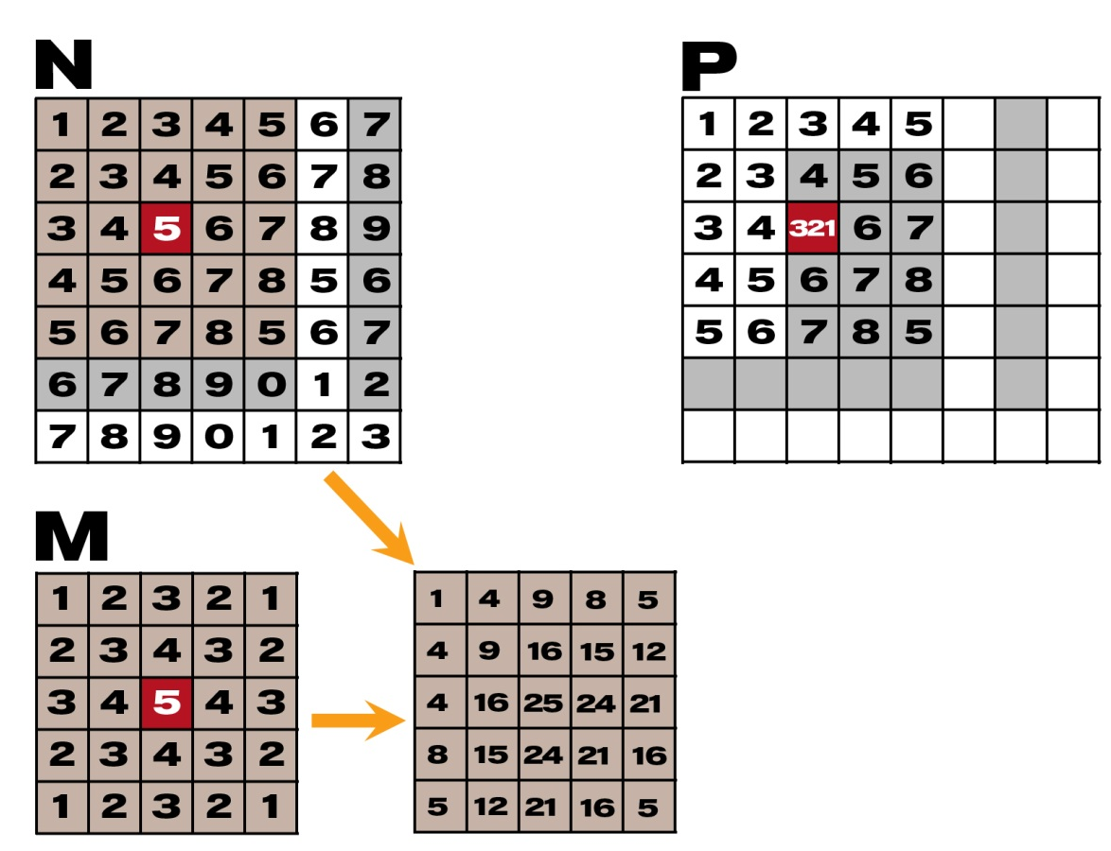
2D Convolution

Slide 11
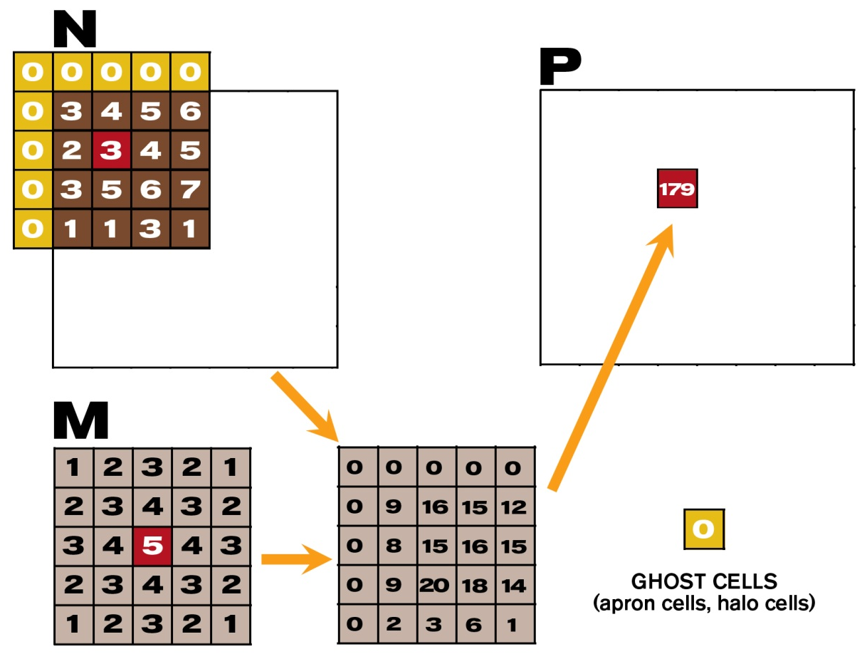
2D Convolution – Ghost Cells

Slide 12
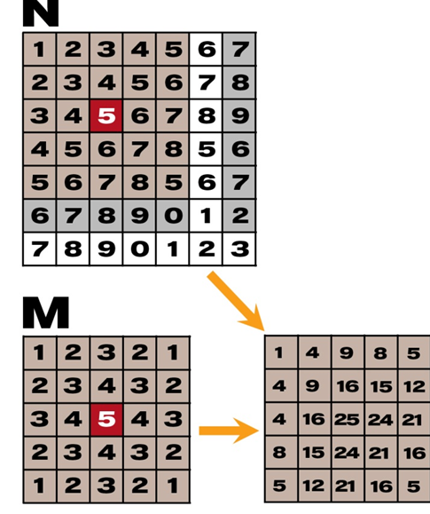
__global__
void convolution_2D_basic_kernel(unsigned char * in, unsigned char * mask, unsigned char * out,
int maskwidth, int w, int h) {
int Col = blockIdx.x * blockDim.x + threadIdx.x;
int Row = blockIdx.y * blockDim.y + threadIdx.y;
if (Col < w && Row < h) {
int pixVal = 0;
N_start_col = Col – (maskwidth/2);
N_start_row = Row – (maskwidth/2);
// Get the of the surrounding box
for(int j = 0; j < maskwidth; ++j) {
for(int k = 0; k < maskwidth; ++k) {
int curRow = N_Start_row + j;
int curCol = N_start_col + k;
// Verify we have a valid image pixel
if(curRow > -1 && curRow < h && curCol > -1 && curCol < w) {
pixVal += in[curRow * w + curCol] * mask[j*maskwidth+k];
}
}
}
// Write our new pixel value out
out[Row * w + Col] = (unsigned char)(pixVal);
}
}
Row
Col

Slide 13
__global__
void convolution_2D_basic_kernel(unsigned char * in, unsigned char * mask, unsigned char * out,
int maskwidth, int w, int h) {
int Col = blockIdx.x * blockDim.x + threadIdx.x;
int Row = blockIdx.y * blockDim.y + threadIdx.y;
if (Col < w && Row < h) {
int pixVal = 0;
N_start_col = Col – (maskwidth/2);
N_start_row = Row – (maskwidth/2);
// Get the of the surrounding box
for(int j = 0; j < maskwidth; ++j) {
for(int k = 0; k < maskwidth; ++k) {
int curRow = N_Start_row + j;
int curCol = N_start_col + k;
// Verify we have a valid image pixel
if(curRow > -1 && curRow < h && curCol > -1 && curCol < w) {
pixVal += in[curRow * w + curCol] * mask[j*maskwidth+k];
}
}
}
// Write our new pixel value out
out[Row * w + Col] = (unsigned char)(pixVal);
}
}
N_start_col
N_start_row

Slide 14
__global__
void convolution_2D_basic_kernel(unsigned char * in, unsigned char * mask, unsigned char * out,
int maskwidth, int w, int h) {
int Col = blockIdx.x * blockDim.x + threadIdx.x;
int Row = blockIdx.y * blockDim.y + threadIdx.y;
if (Col < w && Row < h) {
int pixVal = 0;
N_start_col = Col – (maskwidth/2);
N_start_row = Row – (maskwidth/2);
// Get the of the surrounding box
for(int j = 0; j < maskwidth; ++j) {
for(int k = 0; k < maskwidth; ++k) {
int curRow = N_Start_row + j;
int curCol = N_start_col + k;
// Verify we have a valid image pixel
if(curRow > -1 && curRow < h && curCol > -1 && curCol < w) {
pixVal += in[curRow * w + curCol] * mask[j*maskwidth+k];
}
}
}
// Write our new pixel value out
out[Row * w + Col] = (unsigned char)(pixVal);
}
}

Slide 15
Lecture 8 – Parallel Computation Patterns (Stencil)
CSD2170 Programming Massively Parallel Processors
Lecture 8.2 Tiled Convolution

Slide 16
Objective
To learn about tiled convolution algorithms
Some intricate aspects of tiling algorithms
Output tiles versus input tiles

Slide 17
Tiling Opportunity Convolution
Calculation of adjacent output elements involve shared input elements
E.g., N[2] is used in calculation of P[0], P[1], P[2]. P[3] and P[4] assuming a 1D convolution Mask_Width of width 5
We can load all the input elements required by all threads in a block into the shared memory to reduce global memory accesses
N[0]
N[1]
N[2]
N[3]
N[4]
N[5]
N[6]
1
2
3
4
5
6
7
P[0]
N[0]
N[1]
N[2]
N[3]
N[4]
N[5]
N[6]
1
2
3
4
5
6
7
P[1]
N[0]
N[1]
N[2]
N[3]
N[4]
N[5]
N[6]
1
2
3
4
5
6
7
P[2]
N[0]
N[1]
N[2]
N[3]
N[4]
N[5]
N[6]
1
2
3
4
5
6
7
P[3]
N[0]
N[1]
N[2]
N[3]
N[4]
N[5]
N[6]
1
2
3
4
5
6
7
P[4]

Slide 18
Input Data Needs
Assume that we want to have each block to calculate T output elements
T + Mask_Width -1 input elements are needed to calculate T output elements
T + Mask_Width -1 is usually not a multiple of T, except for small T values
T is usually significantly larger than Mask_Width
N
0
1
2
3
4
5
6
7
8
9
10
11
12
13
14
15
P
0
1
2
3
4
5
6
7
8
9
10
11
12
13
14
15

Slide 19
Definition – output tile
P
0
1
2
3
4
5
6
7
8
9
10
11
12
13
14
15
O_TILE_WIDTH
Each thread block calculates an output tile
Each output tile width is O_TILE_WIDTH
For each thread,
O_TILE_WIDTH is 4 in this example

Slide 20
Definition - Input Tiles
P
0
1
2
3
4
5
6
7
8
9
10
11
12
13
14
15
N
0
1
2
3
4
5
6
7
8
9
10
11
12
13
14
15
Ns
2
3
4
5
6
7
8
9
Each input tile has all values needed to calculate the corresponding output tile.

Slide 21
Two Design Options
Design 1: The size of each thread block matches the size of an output tile
All threads participate in calculating output elements
blockDim.x would be 4 in our example
Some threads need to load more than one input element into the shared memory
Design 2: The size of each thread block matches the size of an input tile
Some threads will not participate in calculating output elements
blockDim.x would be 8 in our example
Each thread loads one input element into the shared memory
We will present Design 2 and leave Design 1 as an exercise.

Slide 22
Thread to Input and Output Data Mapping
P
0
1
2
3
4
5
6
7
8
9
10
11
12
13
14
15
N
0
1
2
3
4
5
6
7
8
9
10
11
12
13
14
15
Thread 0 reads this
Thread 0 writes this
For each thread,
Index_i = index_o – n
were n is Mask_Width /2
n is 2 in this example

Slide 23
All Threads Participate in Loading Input Tiles
float output = 0.0f;
if((index_i >= 0) && (index_i < Width)) {
Ns[tx] = N[index_i];
}
else{
Ns[tx] = 0.0f;
}

Slide 24
Some threads do not participate in calculating output
if (threadIdx.x < O_TILE_WIDTH){
output = 0.0f;
for(j = 0; j < Mask_Width; j++) {
output += M[j] * Ns[j+threadIdx.x];
}
P[index_o] = output;
}
index_o = blockIdx.x*O_TILE_WIDTH + threadIdx.x
Only Threads 0 through O_TILE_WIDTH-1 participate in calculation of output.

Slide 25
Setting Block Size
#define O_TILE_WIDTH 1020
#define BLOCK_WIDTH (O_TILE_WIDTH + 4)
dim3 dimBlock(BLOCK_WIDTH,1, 1);
dim3 dimGrid((Width-1)/O_TILE_WIDTH+1, 1, 1)
The Mask_Width is 5 in this example
In general, block width should be
output tile width + (mask width-1)

Slide 26
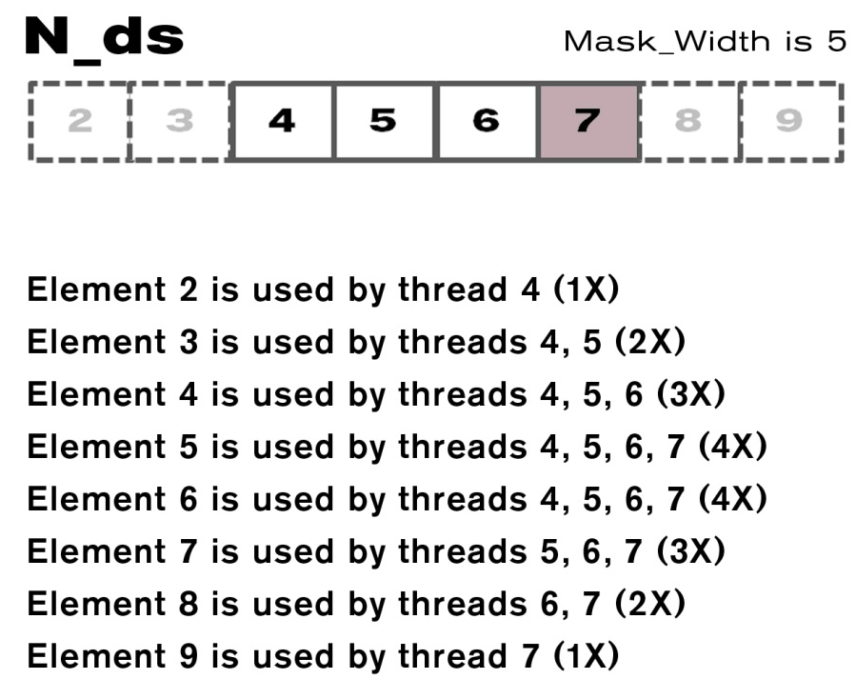
Shared Memory Data Reuse

Slide 27
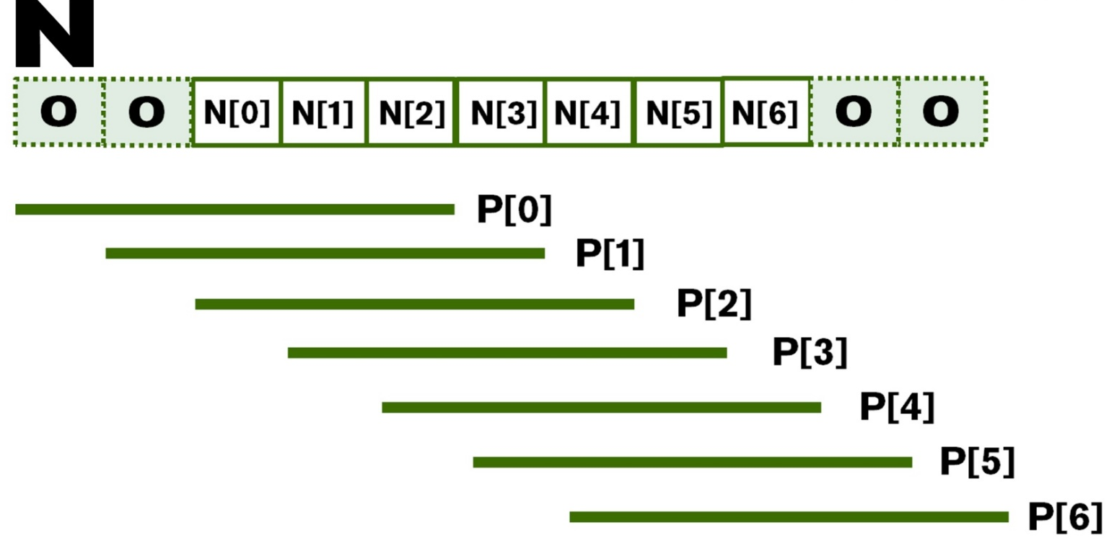
Ghost Cells

Slide 28
Lecture 8 – Parallel Computation Patterns (Stencil)
CSD2170 Programming Massively Parallel Processors
Lecture 8.3 Tile Boundary Conditions

Slide 29
Objective
To learn to write a 2D convolution kernel
2D Image data types and API functions
Using constant caching
Input tiles vs. output tiles in 2D
Thread to data index mapping
Handling boundary conditions

Slide 30
2D Image Matrix with Automated Padding
It is sometimes desirable to pad each row of a 2D matrix to multiples of DRAM bursts
So each row starts at the DRAM burst boundary
Effectively adding columns
This is usually done automatically by matrix allocation function
Pitch can be different for different hardware
Example: a 3X3 matrix padded into a 3X4 matrix
Height is 3
Width is 3
Channels is 1 (See MP Description)
Pitch is 4
width
M_{0,0}
M_{0,1}
M_{0,2}
height
M_{1,0}
M_{1,1}
M_{1,2}
Padded
elements
M_{2,0}
M_{2,1}
M_{2,2}
pitch
3

Slide 31
Row-Major Layout with Pitch
M
Row*Pitch+Col = 2*4+1 = 9
M₀
M₁
M₂
M₃
M₄
M₅
M₆
M₇
M₈
M₉
M₁₀
M₁₁
M
M_{0,0}
M_{0,1}
M_{0,2}
M_{1,0}
M_{1,1}
M_{1,2}
M_{2,0}
M_{2,1}
M_{2,2}
Padded elements
M_{0,0}
M_{0,1}
M_{0,2}
M_{1,0}
M_{1,1}
M_{1,2}
M_{2,0}
M_{2,1}
M_{2,2}

Slide 32
Image Matrix Type in this Course
// Image Matrix Structure declaration
//
typedef struct {
int width;
int height;
int pitch;
int channels;
float* data;
} * wbImage_t;
This type will only be used in the host code of the MP.

Slide 33
wbImage_t API Function for Your Lab
wbImage_t wbImage_new(int height, int width, int channels)
wbImage_t wbImport(char * File);
void wbImage_delete(wbImage_t img)
int wbImage_getWidth(wbImage_t img)
int wbImage_getHeight(wbImage_t img)
int wbImage_getChannels(wbImage_t img)
int wbImage_getPitch(wbImage_t img)
float *wbImage_getData(wbImage_t img)
For simplicity, the pitch of all matrices are set to be
width * channels (no padding) for our labs.
The use of all API functions has been done in the provided host code.

Slide 34
Setting Block Size
#define O_TILE_WIDTH 12
#define BLOCK_WIDTH (O_TILE_WIDTH + 4)
dim3 dimBlock(BLOCK_WIDTH,BLOCK_WIDTH);
dim3 dimGrid((wbImage_getWidth(N)-1)/O_TILE_WIDTH+1, (wbImage_getHeight(N)-1)/O_TILE_WIDTH+1, 1)
In general, BLOCK_WIDTH should be
O_TILE_WIDTH + (MASK_WIDTH-1)

Slide 35
Using constant memory and caching for Mask
Mask is used by all threads but not modified in the convolution kernel
All threads in a warp access the same locations at each point in time
CUDA devices provide constant memory whose contents are aggressively cached
Cached values are broadcast to all threads in a warp
Effectively magnifies memory bandwidth without consuming shared memory
Use of const __restrict__ qualifiers for the mask parameter informs the compiler that it is eligible for constant caching, for example:
__global__ void convolution_2D_kernel(float *P,
float *N, int height, int width, int channels,
const float __restrict__ *M) {

Slide 36
Programmer View of CUDA Memories
Each thread can:
Read/write per-thread registers (~1 cycle)
Read/write per-block shared memory (~5 cycles)
Read/write per-grid global memory (~500 cycles)
Read/only per-grid constant memory (~5 cycles with caching)
Grid
Block (0, 0)
Block (1, 0)
Shared Memory
Shared Memory
Registers
Registers
Registers
Registers
Thread (0, 0)
Thread (1, 0)
Thread (0, 0)
Thread (1, 0)
Host
Global Memory
Constant Memory
Notes:
Global, constant, and texture memory contents are persistent across kernels called by the same application.
Each thread uses a number of registers.
Each block allocates a certain amount of Shared Memory that is accessible to all threads in the block.

Slide 37
More on Constant Caching
Each SM has its own L1 cache
Low latency, high bandwidth access by all threads
However, there is no way for threads in one SM to update the L1 cache in other SMs
No L1 cache coherence
Not a problem if a variable is NOT modified by the kernel
Grid
Block (0, 0)
Block (1, 0)
Shared Memory
Shared Memory
Registers
Registers
Registers
Registers
Thread (0, 0)
Thread (1, 0)
Thread (0, 0)
Thread (1, 0)
Host
Global Memory
Constant Memory

Slide 38
Shifting from output coordinates to input coordinate
int tx = threadIdx.x;
int ty = threadIdx.y;
int row_o = blockIdx.y*O_TILE_WIDTH + ty;
int col_o = blockIdx.x*O_TILE_WIDTH + tx;
int row_i = row_o - 2;
int col_i = col_o - 2;
row_o for
Thread (0,0)
row_i for
Thread (0,0)

Slide 39
Taking Care of Boundaries (1 channel example)
if((row_i >= 0) && (row_i < height) &&
(col_i >= 0) && (col_i < width)) {
Ns[ty][tx] = data[row_i * width + col_i];
} else{
Ns[ty][tx] = 0.0f;
}
Use of width here is OK since pitch is set to width for this MP.

Slide 40
Some threads do not participate in calculating output. (1 channel example)
float output = 0.0f;
if(ty < O_TILE_WIDTH && tx < O_TILE_WIDTH){
for(i = 0; i < MASK_WIDTH; i++) {
for(j = 0; j < MASK_WIDTH; j++) {
output += M[i][j] * Ns[i+ty][j+tx];
}
}

Slide 41
Some threads do not write output (1 channel example)
if(row_o < height && col_o < width)
data[row_o*width + col_o] = output;
You need to write the kernel for a 3-channel (RGB) image.
See more details in the Lab MP Description.

Slide 42
Lecture 8 – Parallel Computation Patterns (Stencil)
CSD2170 Programming Massively Parallel Processors
Lecture 8.4 Analyzing Data Reuse in Tiled Convolution

Slide 43
Objective
To learn to analyze the cost and benefit of tiled parallel convolution algorithms
More complex reuse pattern than matrix multiplication
Less uniform access patterns

Slide 44
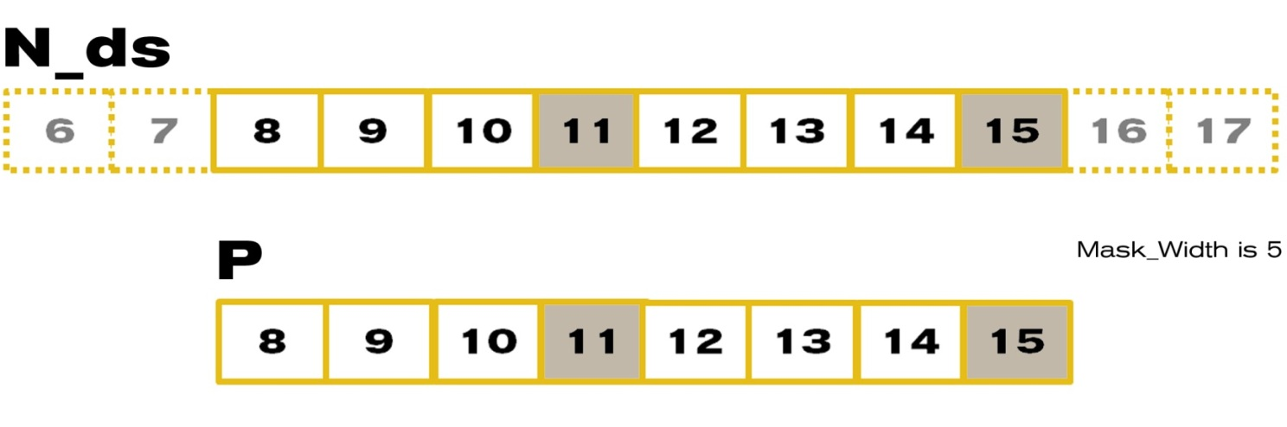
An 8-element Convolution Tile
For Mask_Width=5, we load 8+5-1=12 elements (12 memory loads)

Slide 45
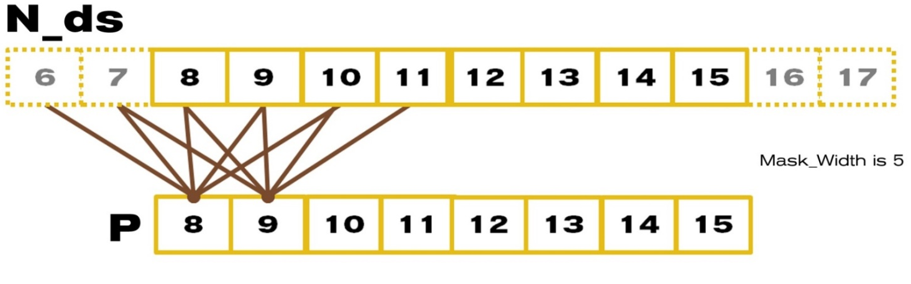
Each output P element uses 5 N elements
P[8] uses N[6], N[7], N[8], N[9], N[10]
P[9] uses N[7], N[8], N[9], N[10], N[11]
P[10] use N[8], N[9], N[10], N[11], N[12]
…
P[14] uses N[12], N[13], N[14], N[15], N[16]
P[15] uses N[13], N[14], N[15], N[16], N[17]

Slide 46
A simple way to calculate tiling benefit
(8+5-1)=12 elements loaded
8*5 global memory accesses replaced by shared memory accesses
This gives a bandwidth reduction of 40/12=3.3

Slide 47
In General, for 1D TILED CONVOLUTION
O_TILE_WIDTH+MASK_WIDTH -1 elements loaded for each input tile
O_TILE_WIDTH*MASK_WIDTH global memory accesses replaced by shared memory accesses
This gives a reduction factor of
(O_TILE_WIDTH*MASK_WIDTH)/(O_TILE_WIDTH+MASK_WIDTH-1)
This ignores ghost elements in edge tiles.

Slide 48
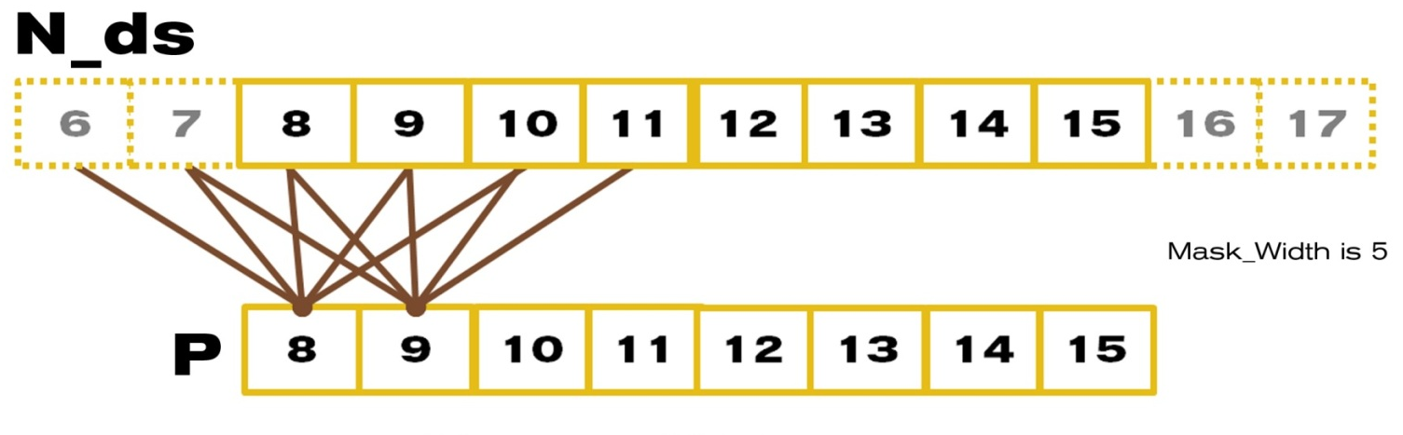
Another Way to Look at Reuse
N[6] is used by P[8] (1X)
N[7] is used by P[8], P[9] (2X)
N[8] is used by P[8], P[9], P[10] (3X)
N[9] is used by P[8], P[9], P[10], P[11] (4X)
N10 is used by P[8], P[9], P[10], P[11], P[12] (5X)
… (5X)
N[14] is used by P[12], P[13], P[14], P[15] (4X)
N[15] is used by P[13], P[14], P[15] (3X)

Slide 49
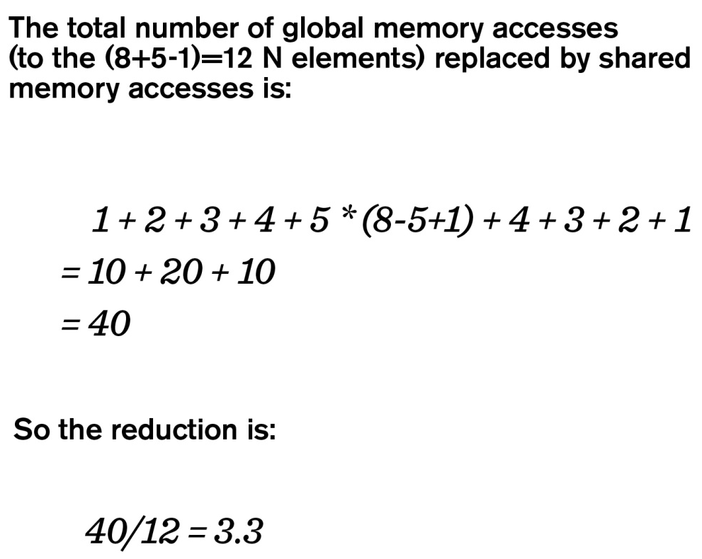
Another Way to Look at Reuse

Slide 50
In General, for 1D
The total number of global memory accesses to the input tile can be calculated as
1 + 2+…+ MASK_WIDTH-1 + MASK_WIDTH*(O_TILE_WIDTH-MASK_WIDTH+1) + MASK_WIDTH-1 + …+ 2 + 1
= MASK_WIDTH * (MASK_WIDTH-1) + MASK_WIDTH *
(O_TILE_WIDTH-MASK_WIDTH+1)
= MASK_WIDTH * O_TILE_WIDTH
For a total of O_TILE_WIDTH + MASK_WIDTH -1 input tile elements

Slide 51
Examples of Bandwidth Reduction for 1D
The reduction ratio is:
MASK_WIDTH * (O_TILE_WIDTH)/(O_TILE_WIDTH+MASK_WIDTH-1)
O_TILE_WIDTH | 16 | 32 | 64 | 128 | 256
MASK_WIDTH = 5 | 4.0 | 4.4 | 4.7 | 4.9 | 4.9
MASK_WIDTH = 9 | 6.0 | 7.2 | 8.0 | 8.5 | 8.7

Slide 52
For 2D Convolution Tiles
(O_TILE_WIDTH+MASK_WIDTH-1)² input elements need to be loaded into shared memory
The calculation of each output element needs to access MASK_WIDTH² input elements
O_TILE_WIDTH² * MASK_WIDTH² global memory accesses are converted into shared memory accesses
The reduction ratio is
O_TILE_WIDTH² * MASK_WIDTH² / (O_TILE_WIDTH+MASK_WIDTH-1)²

Slide 53
Bandwidth Reduction for 2D
The reduction ratio is:
O_TILE_WIDTH² * MASK_WIDTH² / (O_TILE_WIDTH+MASK_WIDTH-1)²
O_TILE_WIDTH | 8 | 16 | 32 | 64
MASK_WIDTH = 5 | 11.1 | 16 | 19.7 | 22.1
MASK_WIDTH = 9 | 20.3 | 36 | 51.8 | 64
Tile size has significant effect on of the memory bandwidth reduction ratio.
This often argues for larger shared memory size.

Slide 54
Lecture 8 – Parallel Computation Patterns (Stencil)
CSD2170 Programming Massively Parallel Processors
Lecture 8.5 Loop Unrolling

Slide 55
Objective
To learn how to unroll the loops that contains memory operations to add more independent, memory operations to the pipeline
2

Slide 56
Example
__global__ void readOffset(float *A, float *B, float *C, const int n, int offset)
{
unsigned int i = blockIdx.x * blockDim.x + threadIdx.x;
unsigned int k = i + offset;
if (k < n)
C[i] = A[k] + B[k];
}

Slide 57
Example
__global__ void readOffsetUnroll4(float *A, float *B, float *C, const int n, int offset) {
unsigned int i = blockIdx.x * blockDim.x * 4 + threadIdx.x;
unsigned int k = i + offset;
if (k < n) C[i] = A[k] + B[k];
if (k + blockDim.x < n) {
C[i + blockDim.x] = A[k + blockDim.x] + B[k + blockDim.x];
}
if (k + 2 * blockDim.x < n) {
C[i + 2 * blockDim.x] = A[k + 2 * blockDim.x] + B[k + 2 * blockDim.x]; }
if (k + 3 * blockDim.x < n) {
C[i + 3 * blockDim.x] = A[k + 3 * blockDim.x] + B[k + 3 * blockDim.x]; }
}

Slide 58
Compiler option
Enable L1 cache with compiler option –Xptxas –dlcm=ca

Slide 59
Parallelism
Unrolling technique may have a tremendous impact on performance, even more than address alignment
The example is I/O-bound kernel, make sense that exposing sufficient memory access parallelism is a high priority
Unrolling does not affect # of memory operations performed (only concurrently in-flight)

Slide 60
Lecture 9 – Parallel Computation Patterns (Reduction)
CSD2170 Programming Massively Parallel Processors
Lecture 9.1 - Parallel Reduction

Slide 61
Objective
To learn the parallel reduction pattern
An important class of parallel computation
Work efficiency analysis
Resource efficiency analysis

Slide 62
“Partition and Summarize”
A commonly used strategy for processing large input data sets
There is no required order of processing elements in a data set (associative and commutative)
Partition the data set into smaller chunks
Have each thread to process a chunk
Use a reduction tree to summarize the results from each chunk into the final answer
E.G., Google and Hadoop MapReduce frameworks support this strategy
We will focus on the reduction tree step for now

Slide 63
Reduction enables other techniques
Reduction is also needed to clean up after some commonly used parallelizing transformations
Privatization
Multiple threads write into an output location
Replicate the output location so that each thread has a private output location (privatization)
Use a reduction tree to combine the values of private locations into the original output location

Slide 64
What is a reduction computation?
Summarize a set of input values into one value using a “reduction operation”
Max
Min
Sum
Product
Often used with a user defined reduction operation function as long as the operation
Is associative and commutative
Has a well-defined identity value (e.g., 0 for sum)
For example, the user may supply a custom “max” function for 3D coordinate data sets where the magnitude for the each coordinate data tuple is the distance from the origin.
An example of “collective operation”

Slide 65
An Efficient Sequential Reduction O(N)
Initialize the result as an identity value for the reduction operation
Smallest possible value for max reduction
Largest possible value for min reduction
0 for sum reduction
1 for product reduction
Iterate through the input and perform the reduction operation between the result value and the current input value
N reduction operations performed for N input values
Each input value is only visited once – an O(N) algorithm
This is a computationally efficient algorithm.

Slide 66
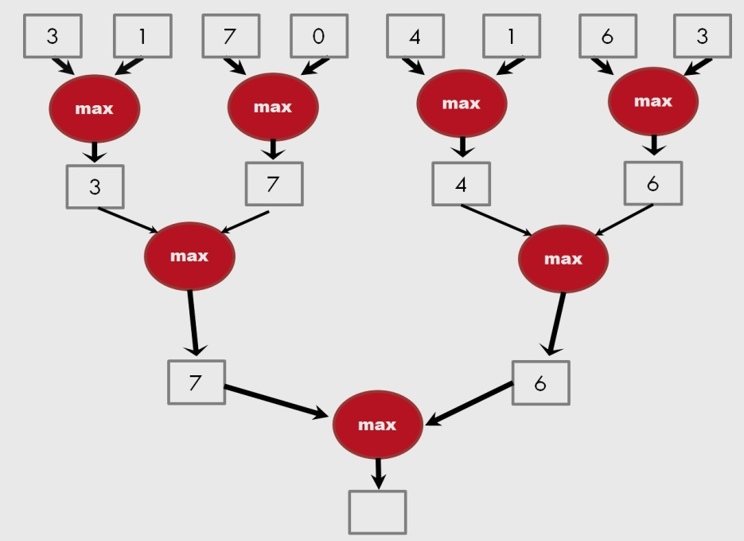
A parallel reduction tree algorithm performs N-1 operations in log(N) steps
13

Slide 67
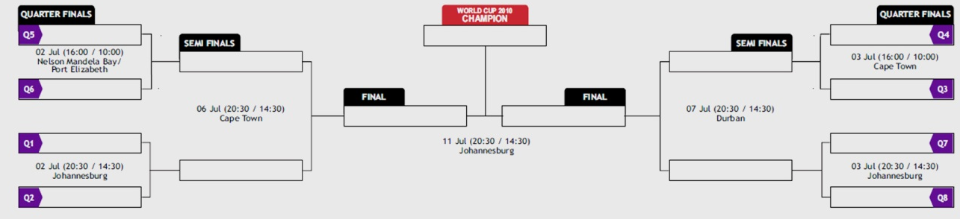
A tournament is a reduction tree with “max” operation

Slide 68
A Quick Analysis
For N input values, the reduction tree performs
(1/2)N + (1/4)N + (1/8)N + … (1) = (1- (1/N))N = N-1 operations
In Log (N) steps – 1,000,000 input values take 20 steps
Assuming that we have enough execution resources
Average Parallelism (N-1)/Log(N))
For N = 1,000,000, average parallelism is 50,000
However, peak resource requirement is 500,000
This is not resource efficient
This is a work-efficient parallel algorithm
The amount of work done is comparable to the an efficient sequential algorithm
Many parallel algorithms are not work efficient

Slide 69
Lecture 9 – Parallel Computation Patterns (Reduction)
CSD2170 Programming Massively Parallel Processors
Lecture 9.2 - A Basic Reduction Kernel

Slide 70
Objective
To learn to write a basic reduction kernel
Thread to data mapping
Turning off threads
Control divergence

Slide 71
Parallel Sum Reduction
Parallel implementation
Each thread adds two values in each step
Recursively halve # of threads
Takes log(n) steps for n elements, requires n/2 threads
Assume an in-place reduction using shared memory
The original vector is in device global memory
The shared memory is used to hold a partial sum vector
Initially, the partial sum vector is simply the original vector
Each step brings the partial sum vector closer to the sum
The final sum will be in element 0 of the partial sum vector
Reduces global memory traffic due to reading and writing partial sum values
Thread block size limits n to be less than or equal to 2,048

Slide 72
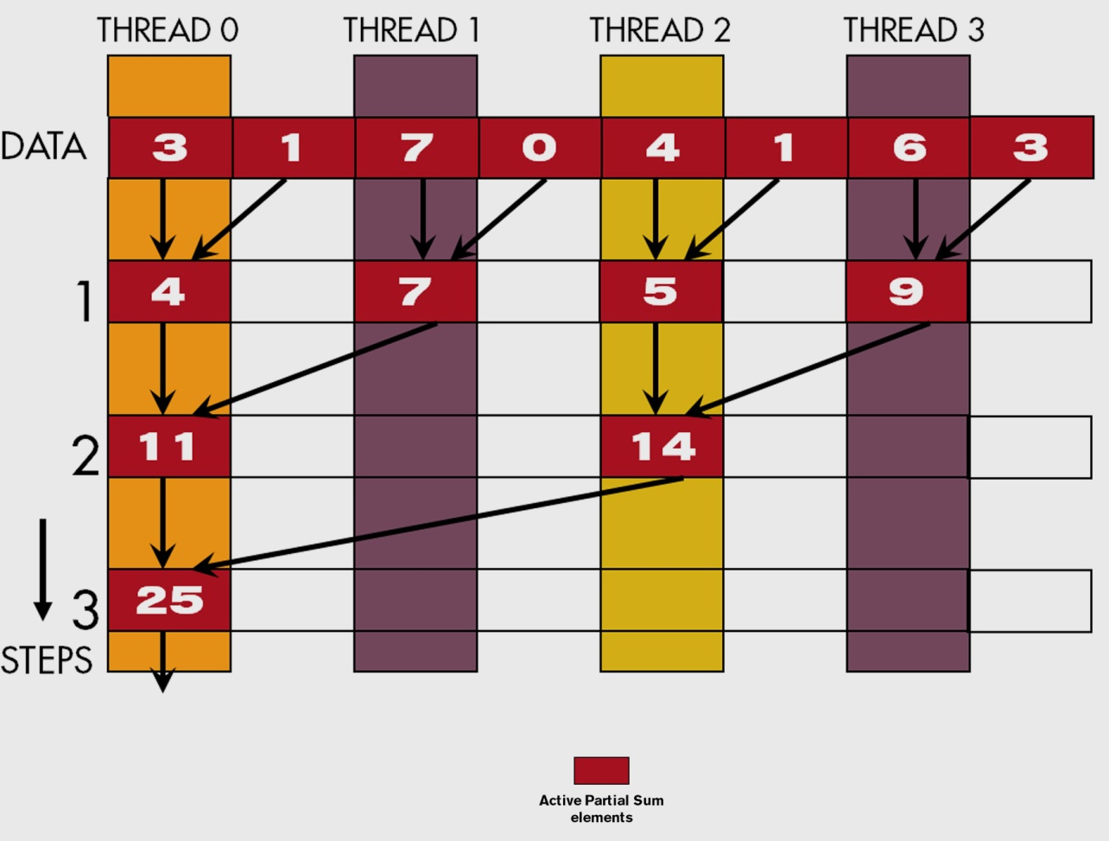
A Parallel Sum Reduction Example

Slide 73
A Naive Thread to Data Mapping
Each thread is responsible for an even-index location of the partial sum vector (location of responsibility)
After each step, half of the threads are no longer needed
One of the inputs is always from the location of responsibility
In each step, one of the inputs comes from an increasing distance away

Slide 74
A Simple Thread Block Design
Each thread block takes 2*BlockDim.x input elements
Each thread loads 2 elements into shared memory
__shared__ float partialSum[2*BLOCK_SIZE];
unsigned int t = threadIdx.x;
unsigned int start = 2*blockIdx.x*blockDim.x;
partialSum[t] = input[start + t];
partialSum[blockDim+t] = input[start + blockDim.x+t];

Slide 75
The Reduction Steps
for (unsigned int stride = 1;
stride <= blockDim.x; stride *= 2)
{
__syncthreads();
if (t % stride == 0)
partialSum[2*t]+= partialSum[2*t+stride];
}
Why do we need __syncthreads()?

Slide 76
Barrier Synchronization
__syncthreads() is needed to ensure that all elements of each version of partial sums have been generated before we proceed to the next step

Slide 77
Back to the Global Picture
At the end of the kernel, Thread 0 in each block writes the sum of the thread block in partialSum[0] into a vector indexed by the blockIdx.x
There can be a large number of such sums if the original vector is very large
The host code may iterate and launch another kernel
If there are only a small number of sums, the host can simply transfer the data back and add them together
Alternatively, Thread 0 of each block could use atomic operations to accumulate into a global sum variable.

Slide 78
Lecture 9 – Parallel Computation Patterns (Reduction)
CSD2170 Programming Massively Parallel Processors
Lecture 9.3 - A Better Reduction Kernel

Slide 79
Objective
To learn to write a better reduction kernel
Improved resource efficiency
Improved thread to data mapping
Reduced control divergence

Slide 80
Some Observations on the naïve reduction kernel
In each iteration, two control flow paths will be sequentially traversed for each warp
Threads that perform addition and threads that do not
Threads that do not perform addition still consume execution resources
Half or fewer of threads will be executing after the first step
All odd-index threads are disabled after first step
After the 5th step, entire warps in each block will fail the if test, poor resource utilization but no divergence
This can go on for a while, up to 6 more steps (stride = 32, 64, 128, 256, 512, 1024), where each active warp only has one productive thread until all warps in a block retire

Slide 81
Thread Index Usage Matters
In some algorithms, one can shift the index usage to improve the divergence behavior
Commutative and associative operators
Always compact the partial sums into the front locations in the partialSum[ ] array
Keep the active threads consecutive

Slide 82
An Example of 4 threads
Thread 0
Thread 1
Thread 2
Thread 3
3
1
7
0
4
1
6
3
7
2
13
3
20
5
25

Slide 83
A Better Reduction Kernel
for (unsigned int stride = blockDim.x;
stride > 0; stride /= 2)
{
__syncthreads();
if (t < stride)
partialSum[t] += partialSum[t+stride];
}

Slide 84
A Quick Analysis
For a 1024 thread block
No divergence in the first 5 steps
1024, 512, 256, 128, 64, 32 consecutive threads are active in each step
All threads in each warp either all active or all inactive
The final 5 steps will still have divergence

Slide 85
Lecture 10 – Parallel Computation Patterns (Scan)
CSD2170 Programming Massively Parallel Processors
Lecture 10.1 - Prefix Sum

Slide 86
Objective
To master parallel scan (prefix sum) algorithms
Frequently used for parallel work assignment and resource allocation
A key primitive in many parallel algorithms to convert serial computation into parallel computation
A foundational parallel computation pattern
Work efficiency in parallel code/algorithms
Reading –Mark Harris, Parallel Prefix Sum with CUDA
http://http.developer.nvidia.com/GPUGems3/gpugems3_ch39.html

Slide 87
Inclusive Scan (Prefix-Sum) Definition
Definition: The scan operation takes a binary associative operator ⊕ (pronounced as circle plus), and an array of n elements
[x₀, x₁, …, x_{n-1}],
and returns the array
[x₀, (x₀ ⊕ x₁), …, (x₀ ⊕ x₁ ⊕ … ⊕ x_{n-1})].
Example: If ⊕ is addition, then scan operation on the array would return
[3 1 7 0 4 1 6 3], [3 4 11 11 15 16 22 25].

Slide 88
An Inclusive Scan Application Example
Assume that we have a 100-inch sandwich to feed 10 people
We know how much each person wants in inches
[3 5 2 7 28 4 3 0 8 1]
How do we cut the sandwich quickly?
How much will be left?
Method 1: cut the sections sequentially: 3 inches first, 5 inches second, 2 inches third, etc.
Method 2: calculate prefix sum:
[3, 8, 10, 17, 45, 49, 52, 52, 60, 61] (39 inches left)

Slide 89
Typical Applications of Scan
Scan is a simple and useful parallel building block
Convert recurrences from sequential: for(j=1;j<n;j++) out[j] = out[j-1] + f(j);
Into parallel:
forall(j) { temp[j] = f(j) }; scan(out, temp);
Useful for many parallel algorithms:
Radix sort
Quicksort
String comparison
Lexical analysis
Stream compaction
Polynomial evaluation
Solving recurrences
Tree operations
Histograms, ….

Slide 90
Other Applications
Assigning camping spots
Assigning Farmer’s Market spaces
Allocating memory to parallel threads
Allocating memory buffer space for communication channels
…

Slide 91
An Inclusive Sequential Addition Scan
Given a sequence [x₀, x₁, x₂, ... ]
Calculate output [y₀, y₁, y₂, ... ]
Such that y₀ = x₀
y₁ = x₀ + x₁
y₂ = x₀ + x₁+ x₂
…
Using a recursive definition
y_{i} = y_{i − 1} + x_{i}

Slide 92
A Work Efficient C Implementation
y[0] = x[0];
for (i = 1; i < Max_i; i++) y[i] = y [i-1] + x[i];
Computationally efficient:
N additions needed for N elements - O(N)!
Only slightly more expensive than sequential reduction.

Slide 93
A Naïve Inclusive Parallel Scan
Assign one thread to calculate each y element
Have every thread to add up all x elements needed for the y element
y₀ = x₀
y₁ = x₀ + x₁
y₂ = x₀ + x₁+ x₂
“Parallel programming is easy as long as you do not care about performance.”

Slide 94
Lecture 10 – Parallel Computation Patterns (Scan)
CSD2170 Programming Massively Parallel Processors
Lecture 10.2 - A Work-inefficient Scan Kernel

Slide 95
Objective
To learn to write and analyze a high-performance scan kernel
Interleaved reduction trees
Thread index to data mapping
Barrier Synchronization
Work efficiency analysis

Slide 96
A Better Parallel Scan Algorithm
Read input from device global memory to shared memory
Iterate log(n) times; stride from 1 to n-1: double stride each iteration
XY | 3 | 1 | 7 | 0 | 4 | 1 | 6 | 3
STRIDE 1
XY | 3 | 4 | 8 | 7 | 4 | 5 | 7 | 9
ITERATION = 1
STRIDE = 1
Active threads stride to n-1 (n-stride threads)
Thread j adds elements j and j-stride from shared memory and writes result into element j in shared memory
Requires barrier synchronization, once before read and once before write

Slide 97
A Better Parallel Scan Algorithm
Read input from device to shared memory
Iterate log(n) times; stride from 1 to n-1: double stride each iteration.
XY | 3 | 1 | 7 | 0 | 4 | 1 | 6 | 3
STRIDE 1
XY | 3 | 4 | 8 | 7 | 4 | 5 | 7 | 9
STRIDE 2
XY | 3 | 4 | 11 | 11 | 12 | 12 | 11 | 14
ITERATION = 2
STRIDE = 2

Slide 98
A Better Parallel Scan Algorithm
Read input from device to shared memory
Iterate log(n) times; stride from 1 to n-1: double stride each iteration
Write output from shared memory to device memory
XY | 3 | 1 | 7 | 0 | 4 | 1 | 6 | 3
STRIDE 1
XY | 3 | 4 | 8 | 7 | 4 | 5 | 7 | 9
STRIDE 2
XY | 3 | 4 | 11 | 11 | 12 | 12 | 11 | 14
STRIDE 4
XY | 3 | 4 | 11 | 11 | 15 | 16 | 22 | 25
ITERATION = 3
STRIDE = 4

Slide 99
Handling Dependencies
During every iteration, each thread can overwrite the input of another thread
Barrier synchronization to ensure all inputs have been properly generated
All threads secure input operand that can be overwritten by another thread
Barrier synchronization is required to ensure that all threads have secured their inputs
All threads perform addition and write output
XY | 3 | 1 | 7 | 0 | 4 | 1 | 6 | 3
STRIDE 1
XY | 3 | 4 | 8 | 7 | 4 | 5 | 7 | 9
ITERATION = 1
STRIDE = 1

Slide 100
A Work-Inefficient Scan Kernel
__global__ void work_inefficient_scan_kernel(float *X, float *Y, int InputSize) {
__shared__ float XY[SECTION_SIZE];
int i = blockIdx.x * blockDim.x + threadIdx.x;
if (i < InputSize) {XY[threadIdx.x] = X[i];}
// the code below performs iterative scan on XY
for (unsigned int stride = 1; stride <= threadIdx.x; stride *= 2) {
__syncthreads();
float in1 = XY[threadIdx.x - stride];
__syncthreads();
XY[threadIdx.x] += in1;
}
__ syncthreads();
If (i < InputSize) {Y[i] = XY[threadIdx.x];}
}

Slide 101
Work Efficiency Considerations
This Scan executes log(n) parallel iterations
The iterations do (n-1), (n-2), (n-4),..(n- n/2) adds each
Total adds: n * log(n) - (n-1) → O(n*log(n)) work
This scan algorithm is not work efficient
Sequential scan algorithm does n adds
A factor of log(n) can hurt: 10x for 1024 elements!
A parallel algorithm can be slower than a sequential one when execution resources are saturated from low work efficiency
Notes:
Comment on the frequent double barrier synchronization. Need more blocks per Streaming Processors to ensure high execution throughput

Slide 102
Lecture 10 – Parallel Computation Patterns (Scan)
CSD2170 Programming Massively Parallel Processors
A Work-Efficient Parallel Scan Kernel

Slide 103
Objective
To learn to write a work-efficient scan kernel
Two-phased balanced tree traversal
Aggressive re-use of intermediate results
Reducing control divergence with more complex thread index to data index mapping

Slide 104
Improving Efficiency
Balanced Trees
Form a balanced binary tree on the input data and sweep it to and from the root
Tree is not an actual data structure, but a concept to determine what each thread does at each step
For scan:
Traverse down from leaves to the root building partial sums at internal nodes in the tree
The root holds the sum of all leaves
Traverse back up the tree building the output from the partial sums

Slide 105
Parallel Scan - Reduction Phase
x₀
x₁
x₂
x₃
x₄
x₅
x₆
x₇
+
+
+
+
Time
∑x_{0..}x₁
∑x_{2..}x₃
∑x_{4..}x₅
∑x_{6..}x₇
+
+
∑x_{0..}x₃
∑x_{4..}x₇
+
In-place calculation
∑x_{0..}x₇
Value after reduce

Slide 106
Reduction Phase Kernel Code
// XY[2*BLOCK_SIZE] is in shared memory
for (unsigned int stride = 1;stride <= BLOCK_SIZE; stride *= 2) {
int index = (threadIdx.x+1)*stride*2 - 1;
if(index < 2*BLOCK_SIZE)
XY[index] += XY[index-stride];
__syncthreads();
}
threadIdx.x+1 = 1, 2, 3, 4….
stride = 1,
index = 1, 3, 5, 7, …

Slide 107
Parallel Scan - Post Reduction Reverse Phase
x₀
∑x_{0..}x₁
x₂
∑x_{0..}x₃
x₄
∑x_{4..}x₅
x₆
∑x_{0..}x₇
+
∑x_{0..}x₅
Move (add) a critical value to a central location where it is needed

Slide 108
Parallel Scan - Post Reduction Reverse Phase
x₀
∑x0..x1
x₂
∑x0..x3
x₄
∑x4..x5
x₆
∑x0..x7
+
∑x0..x5
+
+
+
∑x_{0..}x₂
∑x_{0..}x₄
∑x_{0..}x₆

Slide 109
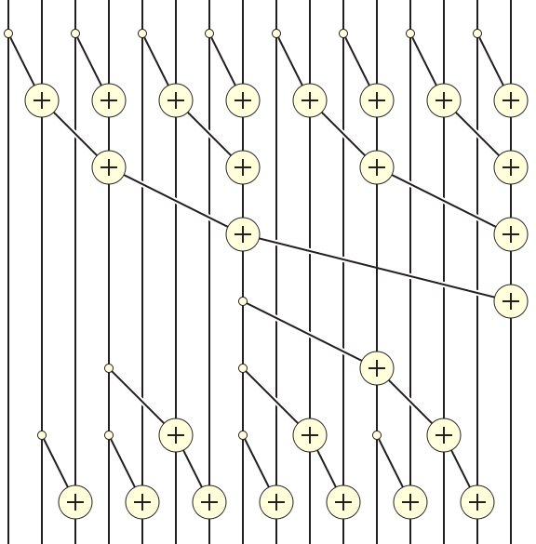
Putting it Together

Slide 110
Post Reduction Reverse Phase Kernel Code
for (unsigned int stride = BLOCK_SIZE/2; stride > 0; stride /= 2) {
__syncthreads();
int index = (threadIdx.x+1)*stride*2 - 1;
if(index+stride < 2*BLOCK_SIZE) {
XY[index + stride] += XY[index];
}
}
__syncthreads();
if (i < InputSize) Y[i] = XY[threadIdx.x];
First iteration for 16-element section
threadIdx.x = 0
stride = BLOCK_SIZE/2 = 8/2 = 4
index = 8-1 = 7

Slide 111
Lecture 10 – Parallel Computation Patterns (Scan)
CSD2170 Programming Massively Parallel Processors
Lecture 10.4 More on Parallel Scan

Slide 112
Objective
To learn more about parallel scan
Analysis of the work efficient kernel
Exclusive scan
Handling very large input vectors

Slide 113
Work Analysis of the Work Efficient Kernel
The work efficient kernel executes log(n) parallel iterations in the reduction step
The iterations do n/2, n/4,..1 adds
Total adds: (n-1) → O(n) work
It executes log(n)-1 parallel iterations in the post-reduction reverse step
The iterations do 2-1, 4-1, …. n/2-1 adds
Total adds: (n-2) – (log(n)-1) → O(n) work
Both phases perform up to no more than 2x(n-1) adds
The total number of adds is no more than twice of that done in the efficient sequential algorithm
The benefit of parallelism can easily overcome the 2X work when there is sufficient hardware

Slide 114
Some Tradeoffs
The work efficient scan kernel is normally more desirable
Better Energy efficiency
Less execution resource requirement
However, the work inefficient kernel could be better for absolute performance due to its single-phase nature (forward phase only)
There is sufficient execution resource

Slide 115
Handling Large Input Vectors
Build on the work efficient scan kernel
Have each section of 2*blockDim.x elements assigned to a block
Perform parallel scan on each section
Have each block write the sum of its section into a Sum[] array indexed by blockIdx.x
Run the scan kernel on the Sum[] array
Add the scanned Sum[] array values to all the elements of corresponding sections
Adaptation of work inefficient kernel is similar.

Slide 116
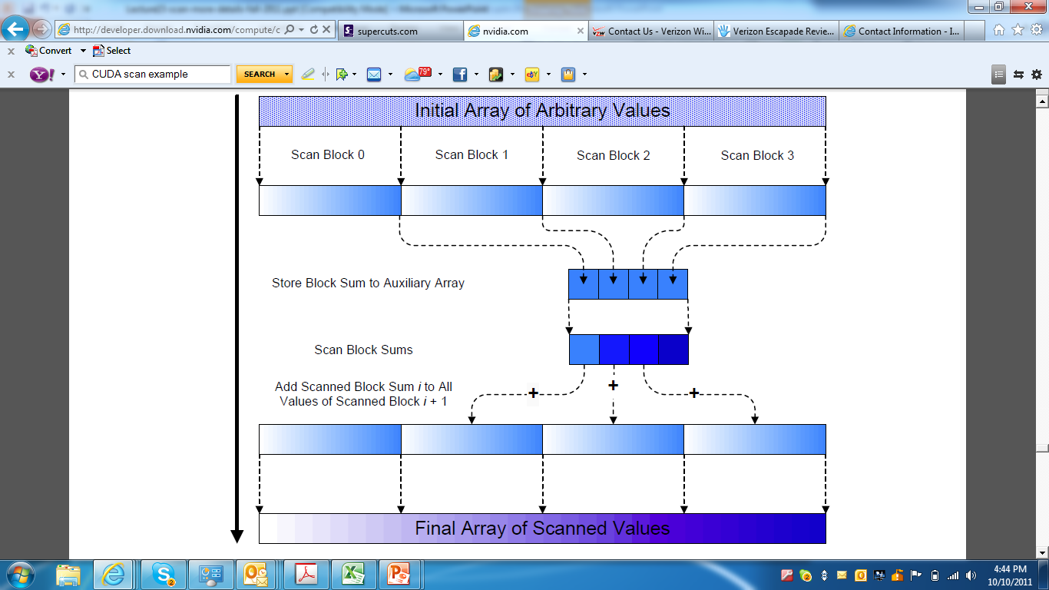
Overall Flow of Complete Scan

Slide 117
Exclusive Scan Definition
Definition: The exclusive scan operation takes a binary associative operator ⊕, and an array of n elements
[x₀, x₁, …, x_{n-1}]
and returns the array
[0, x₀, (x₀ ⊕ x₁), …, (x₀ ⊕ x₁ ⊕ … ⊕ x_{n-2})].
Example: If ⊕ is addition, then the exclusive scan operation
on the array [3 1 7 0 4 1 6 3],
would return [0 3 4 11 11 15 16 22].

Slide 118
Why Use Exclusive Scan?
To find the beginning address of allocated buffers
Inclusive and exclusive scans can be easily derived from each other; it is a matter of convenience
[3 1 7 0 4 1 6 3]
Exclusive [0 3 4 11 11 15 16 22]
Inclusive [3 4 11 11 15 16 22 25]

Slide 119
A Simple Exclusive Scan Kernel
Adapt an inclusive, work inefficient scan kernel
Block 0:
Thread 0 loads 0 into XY[0]
Other threads load X[threadIdx.x-1] into XY[threadIdx.x]
All other blocks:
All thread load X[blockIdx.x*blockDim.x+threadIdx.x-1] into XY[threadIdex.x]
Similar adaption for work efficient scan kernel but ensure that each thread loads two elements
Only one zero should be loaded
All elements should be shifted to the right by only one position
Read the Harris article (Parallel Prefix Sum with CUDA) for a more intellectually interesting approach to exclusive scan kernel implementation.

